Slide 1
C3: Intelligent Infectious Disease Spread Simulation and Analysis
01/19/2021

Slide 2
Related work
What work should be looked at:
Mixture of SEIR and Agent Based Models for COVID-19 Analysis and Prediction
Any papers using Safegraph data for COVID-19
Parameter selection using Practical Swarm Optimization in the context of COVID-19.

Slide 3
Future Plan
Use AWS cloud computing service for optimized model testing.
Look for data about people’s trajectories
Add more types of POI (school, workplace, or home contacts)
Enhance the description of the design (parameters of agents and POI, how POI are visited by individuals? ...)
Employ enhanced statistical significance test, based on existing literature
Completely overhaul parameter selection strategies, using Particle Swarm Optimization.
Use generalized net methodology to model the initial population.

Slide 4
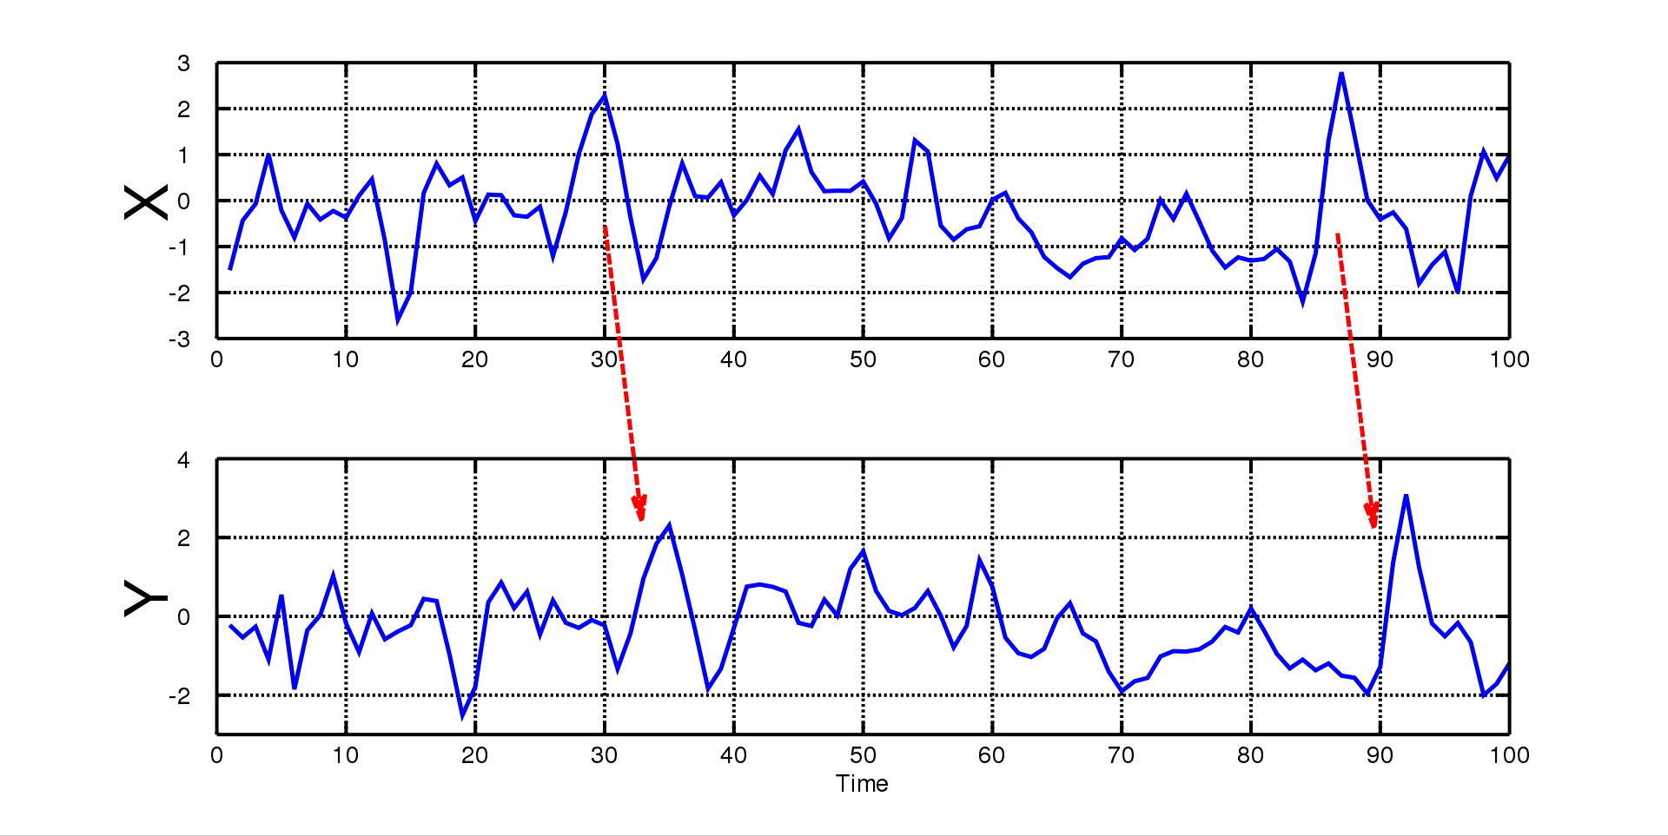
Enhanced Statistical Significance Test
Ensure common frequency of measurement between existing Covid-19 data and predicted model.
Combine two approaches:
Granger causality test: A statistical hypothesis test for determining whether one time series is useful in forecasting another
Identify a common model, such as an ARIMA model or a multiply-trended Regression Model, that would reasonably describe each series separately.

Slide 5
Cloud Computing
Use AWS cloud computing service for optimized model testing.
Avoid previous problems with undercounting, and simulate the entire Houston population.
Preferably use something like Sagemaker.
Else, run our Python script on an EC2 instance, and use a terminal multiplexer (preferably tmux) to keep the session running after logging out.

Slide 6
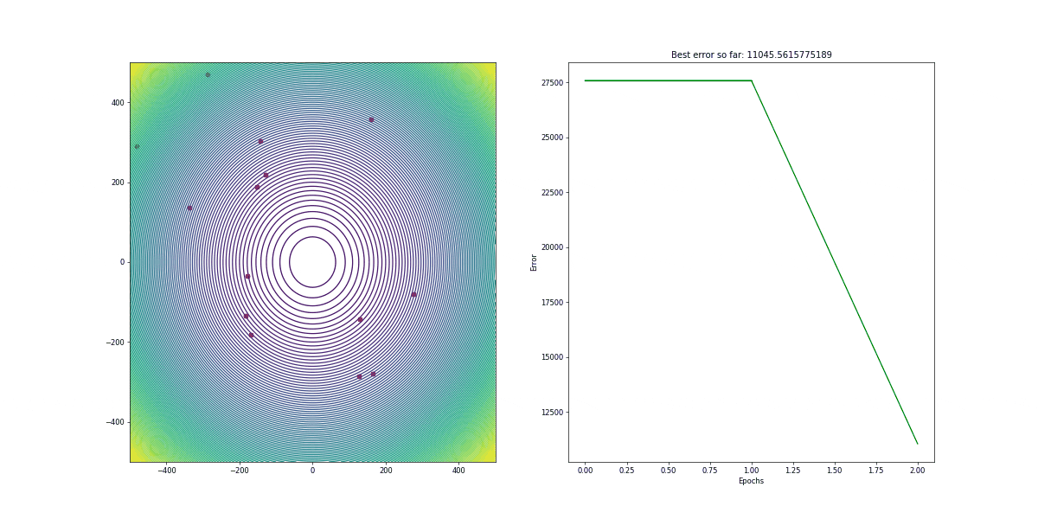
Parameter Selection Strategy
Settled on using Particle Swarm Optimization.
Use PySwarms, which is an extensible research toolkit for PSO in Python.
Due to possible scaling issues, start with 1:1000 size model as in our original paper.
Then keep scaling up.
Literature suggests using the Rastrigin function for performance testing.

Slide 7
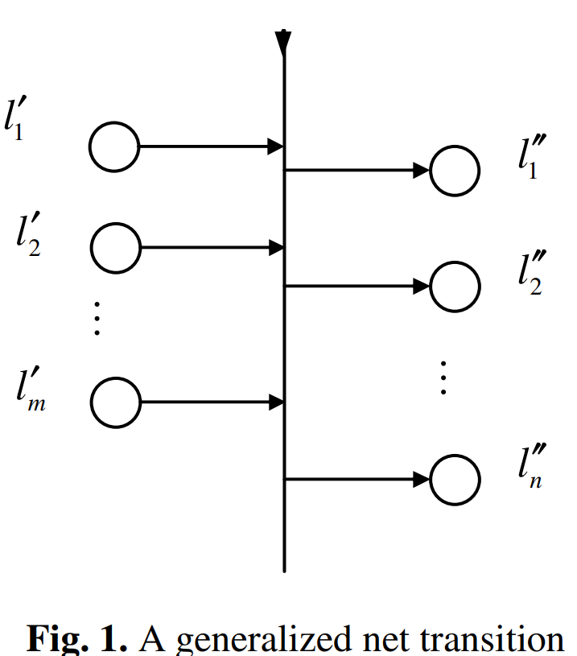
Generalized Nets
Speculative.
The generalized net methodology was developed as a counterpart of Petri nets. The methodology allows to model different kinds of discrete dynamic systems.
Generalized nets contain tokens, which are transferred from place to place.
Every token bears some information, which is described by token’s characteristic, and any token enters the net with an initial characteristic.
After passing a transition the tokens’ characteristics are modified.

Slide 8
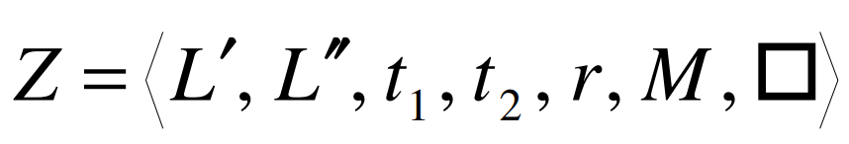
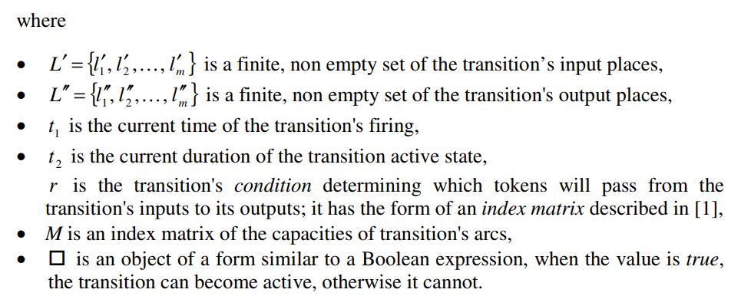
Generalized Nets (continued)
The transition has input and output places,. Formally, every transition is described by a seven-tuple:

Slide 9
References
A Novel Modeling Methodology: Generalized Nets
An Intelligent Parameter Selection Method for Particle Swarm Optimization Algorithm - IEEE Conference Publication
How to statistically compare two time series? - Cross Validated
Train a Model with Amazon SageMaker - Amazon SageMaker
Welcome to PySwarms's documentation! — PySwarms 1.3.0 documentation
Rastrigin function - Wikipedia

